Slide 1

Portfolio Management System
BY,
Naveen Kumar R S
Saravana Kumar V
Rasith Meeran A
Sridhar N
(Ramco Institute of Technology)

Slide 2

The Investment Challenge
Inefficient Manual Tracking
Investors struggle with manual portfolio updates. This leads to errors and missed opportunities.
Lack of Integrated Analysis
Existing tools often lack integrated technical or fundamental analysis. This limits informed decision-making.
Limited Data Access
There is no easy access to stock-specific news. Also, profit/loss summaries are often missing.

Slide 3






Our System's Objectives & Features
Personalised Portfolios
Transaction Tracking
Users can create and manage their unique stock portfolios.
Add transactions and automatically update holdings. See real-time changes.
Key Metric Displays
Company Insights
View EPS, PE Ratio, RSI, ROE, ADX, MACD easily. Make data-driven decisions.
Access company news, profiles, and dividend history. Stay informed on your investments.
Smart Suggestions
Receive buy/sell actions based on in-depth analytics. Optimize your strategy.

Slide 4
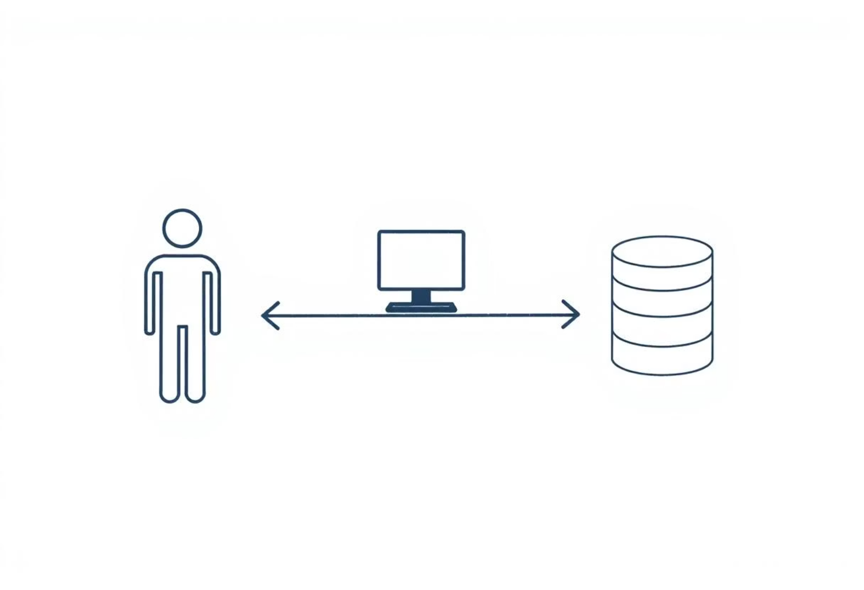




System Architecture Overview
The system uses a clear, modular design. It provides a clean user interface. It handles real-time data efficiently.
Frontend
Built with HTML, CSS, and Bootstrap for a responsive design.
Backend
Powered by Flask and Python, handling logic and data processing.
Database
MySQL manages all portfolio and company data reliably.

Slide 5
ER Diagram & Database Design
Our database is designed for scalability. It is normalized for relational integrity. Key entities include User, Transactions, Company, Technical Signals, News, Watchlist, and Dividends. This structure ensures data consistency.

Slide 6
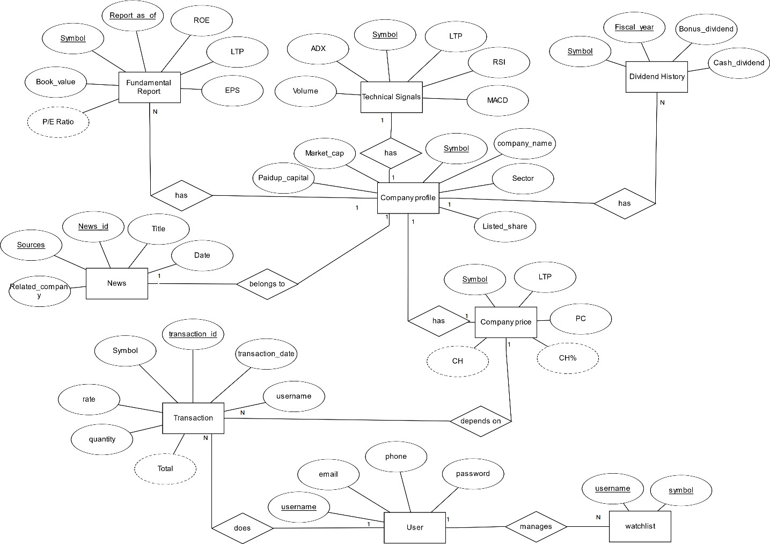

Slide 7

Implementation Highlights
Financial Filtering
SQL Functions
Companies can be filtered based on strong financial signals. This aids investment choices.
Stored Procedures
Calculations for capital gain tax and brokerage are automated. This ensures accuracy.
Used for efficient portfolio analysis. This speeds up data retrieval.

Slide 8
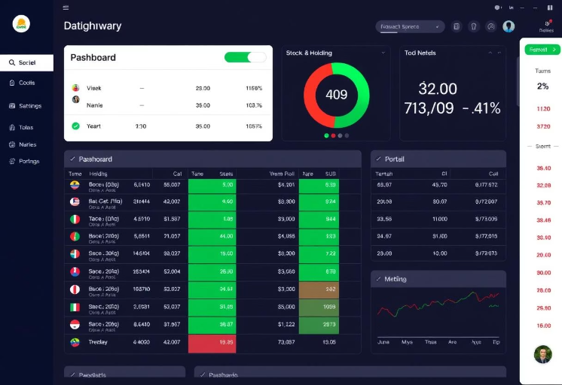
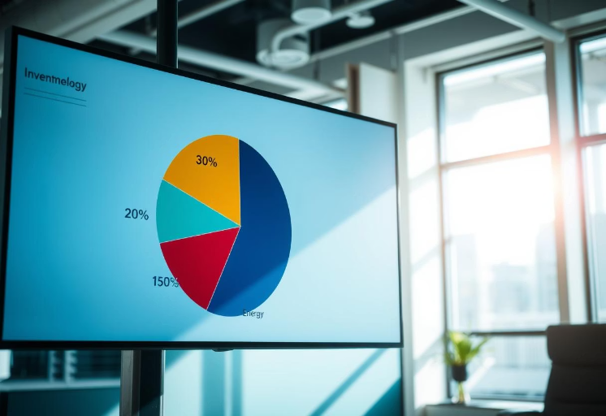
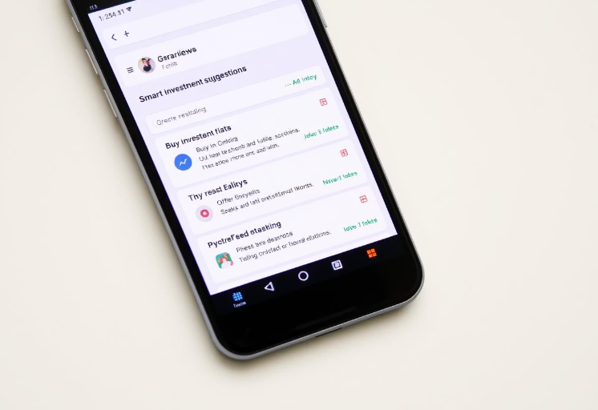
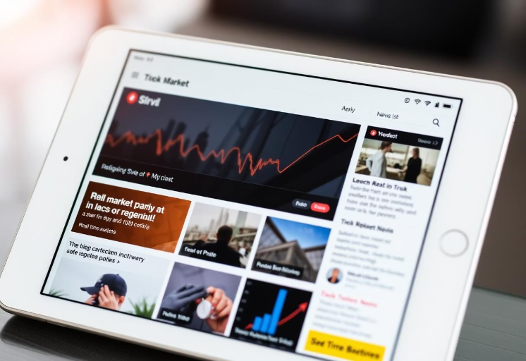
Features in Action
Holdings Summary
Sector-wise Visualization
Smart Suggestions
Watchlist News Feed
Get a concise overview of all your current stock holdings.
Receive best company recommendations based on EPS and RSI. Optimize your decisions.
Stay updated with real-time news for companies on your watchlist. Crucial for timely decisions.
A pie chart visualizes your investments by sector. Understand your asset allocation.

Slide 9
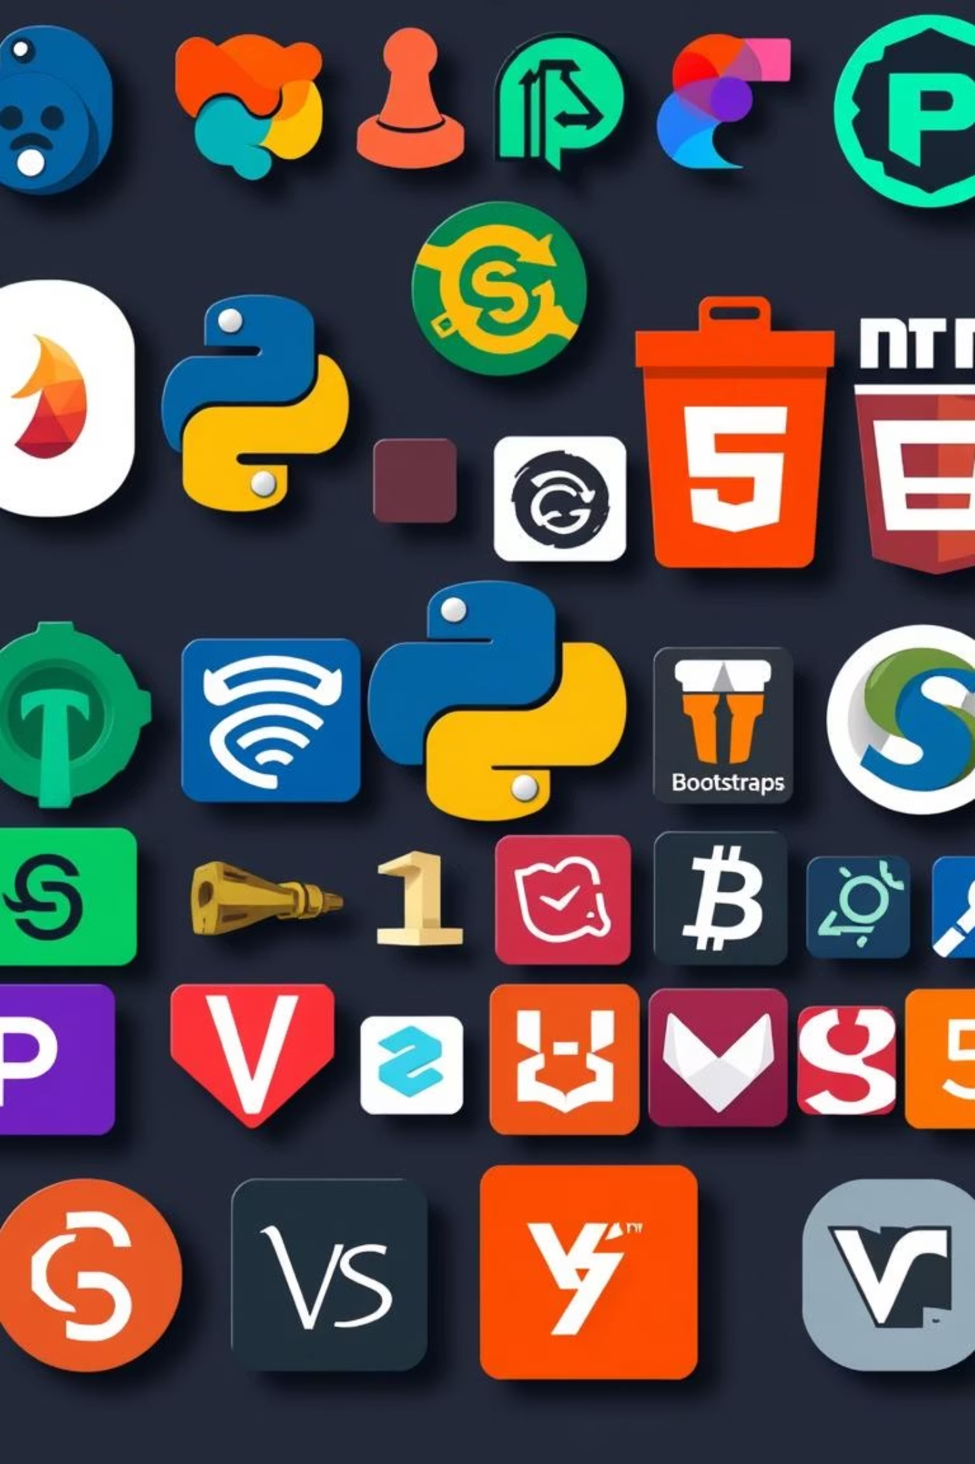
Tech Stack & Tools
Our project leverages a robust set of technologies. These ensure a stable and efficient system.
Languages
Frameworks & Libraries
Python, HTML, CSS, SQL form the core. Enabling full functionality.
Flask and Bootstrap provide structure. They ensure a responsive UI.
Tools Utilised
VS Code, MySQL Workbench, SQLite3 aid development. They streamline database management.

Slide 10

Conclusion & Future Scope
The project successfully integrates DBMS principles. It provides a strong UI logic.
Registration Page
Connect the registration page to the backend for seamless user onboarding.
Admin Dashboard
Develop an admin dashboard for comprehensive system management and oversight.
Real-time APIs
Integrate real-time stock APIs for the most current market data. Enhance accuracy.
Cloud Deployment
Deploy the system to the cloud for enhanced scalability and accessibility.

